Slide 1

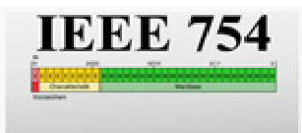
IEEE 754 Floating Point Arithmetic
Department of Computer Engg. & Applications
GLA University, Mathura

Slide 2
IEEE
IEEE, pronounced "Eye-triple-E," stands for the Institute of Electrical and Electronics Engineers.

Slide 3
Floating Point Number
A floating-point number is a Rational Number, because it can be represented as one integer divided by another.
Example: 1.45×10³ is
(145/100)×1000
or
145,000/100.

Slide 4
IEEE 754
It is IEEE Standard for Floating-Point Arithmetic.
It is a technical standard for floating-point Representation which was established in 1985 by the Institute of Electrical and Electronics Engineers (IEEE).

Slide 5
Components of IEEE 754
IEEE 754 is the most efficient in most cases. IEEE 754 has 3 basic components:
Sign (+ve or –ve)
The Biased exponent
The Normalized Mantissa

Slide 6
Component 1: Sign (+ve or –ve)
0 represents a positive number
1 represents a negative number.
For example: 28.017 the sign is +ve. So it will be represent by 0.
-28.017 the sign is -ve. So it will be represent by 1.

Slide 7
Component 2: The Biased exponent
The exponent field needs to represent both positive and negative exponents. A bias is added to the actual exponent in order to get the stored exponent.
The value of bias based of size of exponent component.
For example:
if size of exponent field is 8 bits then bias value is
2^{size-1}-1 =127
if size of exponent field is 11 bits then bias value is
2^{size-1}-1 =1023

Slide 8
Component 3: The Normalized Mantissa
The mantissa is part of a number in scientific notation or a floating-point number, consisting of its significant digits.
A normalized mantissa is one with only one 1 to the left of the decimal like 1.mmmmmmmmmm….mmmmm
Example: 8.25
Binary Representation : 1000.01
Normalized Mantissa : 1.00001 x 2⁺³

Slide 9
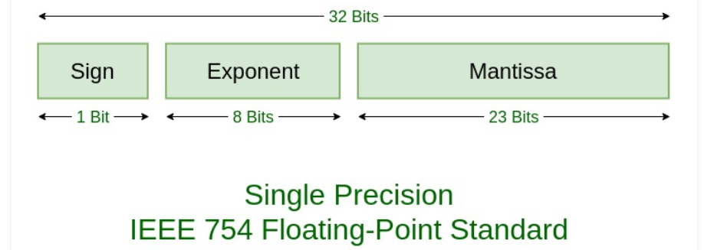
Representation of IEEE 754
There are two types of representation:
Single precision
(+ve or –ve sign) 1.mantissa x 2 ^{Exponent-127}

Slide 10
Single Precision Example
Question: Represent 85.125 in IEEE 32 bits Format.
Binary of 85 = 1010101
Binary of 0.125 = 001
Floating Point Number 85.125 = 1010101.001 =1.010101001 x 2⁺⁶
So, Sign component: 0 because of +ve sign.
biased exponent: 127+6=133
Binary of 133 = 10000101
Normalized mantissa = 010101001
we will add 0's to complete the 23 bits in mantissa

Slide 11
The IEEE 754 Single precision is: =
32bits :
0 10000101 01010100100000000000000
Sign Exponent Mantissa
1bit 8bits 23bits
This can be written in hexadecimal form 42AA4000 in Computer.
0
10000101
01010100100000000000000

Slide 12
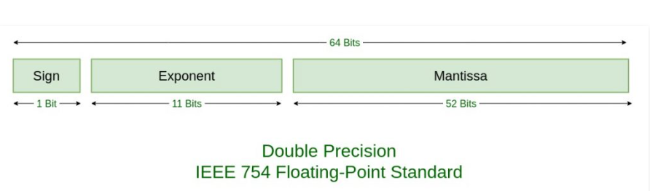
2. Double precision
(+ve or –ve sign) 1.mantissa x 2 ^{Exponent-1023}

Slide 13
Double Precision Example
Question: Represent 85.125 in IEEE 64 bits Format.
Binary of 85 = 1010101
Binary of 0.125 = 001
Floating Point Number 85.125 = 1010101.001 =1.010101001 x 2⁺⁶
So, Sign component: 0 because of +ve sign.
Biased exponent: 1023+6=1029
Binary of 1029 = 10000000101
Normalized mantissa = 010101001
we will add 0's to complete the 52 bits in mantissa

Slide 14
The IEEE 754 Double precision is
64 bits :
010000000101 0101010010000000000000000000000000000000000000000000
Sign Exponent Mantissa
1bit 11bits 52bits
This can be written in hexadecimal form 4055480000000000 in Computer.
0
10000000101
0101010010000000000000000000000000000000000000000000

Slide 15
Compute the largest and smallest positive numbers that can be represented in the 32-bit normalized form.
Compute the largest and smallest negative numbers can be represented in the 32-bit normalized form.
Repeat (1) for the 32-bit denormalized form.
Repeat (2) for the 32-bit denormalized form.

Slide 16
Numerical to do:
1. Represent 100.125 in IEEE 754 single and double precision.
2. Represent -50.25 in IEEE 754 single and double precision.
Challenging Questions:
3. Represent -50.33 in IEEE 754 single and double precision.
4. Represent zero, Infinity and Not a Number(NaN) in IEEE 754 single precision.

Slide 17
Answers:
Zero –
Zero is a special value denoted with an exponent and mantissa of 0. -0 and +0 are distinct values, though they both are equal.
Denormalized –
If the exponent is all zeros, but the mantissa is not then the value is a denormalized number. This means this number does not have an assumed leading one before the binary point.
Infinity –
The values +infinity and -infinity are denoted with an exponent of all ones and a mantissa of all zeros. The sign bit distinguishes between negative infinity and positive infinity. Operations with infinite values are well defined in IEEE.
Not A Number (NAN) –
The value NAN is used to represent a value that is an error. This is represented when exponent field is all ones with a zero sign bit or a mantissa that it not 1 followed by zeros. This is a special value that might be used to denote a variable that doesn’t yet hold a value.

Slide 18
EXPONENT | MANTISA | VALUE
0 | 0 | exact 0
255 | 0 | Infinity
0 | not 0 | denormalised
255 | not 0 | Not a number (NAN)

